Slide 1
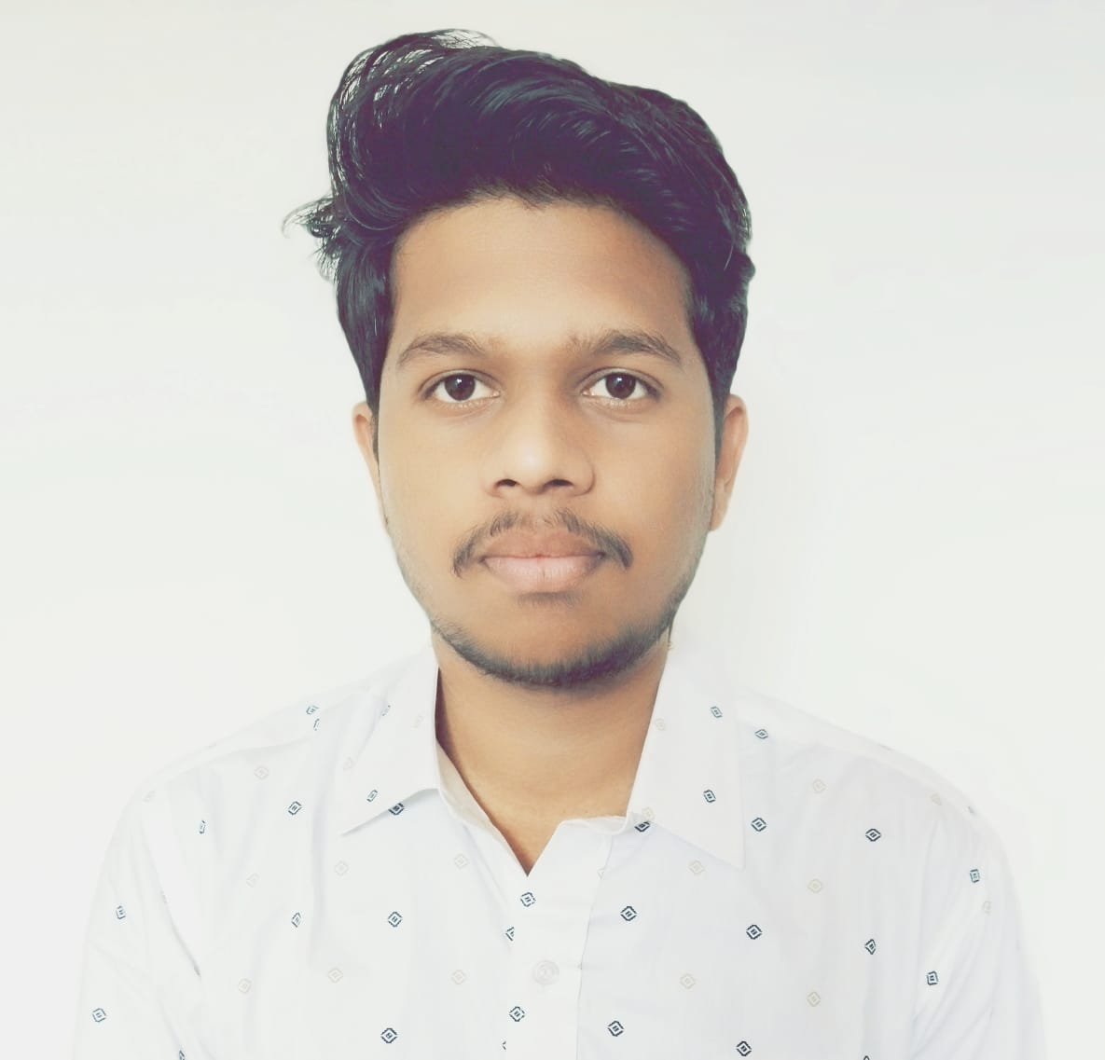




Ankush Dnyaneshwar Marathe
Analyst/Software Engineer
Bachelor of Engineering
Computer Science : 2018 - 2022
Skills
Java 8 /J2EE | Java Basics, OOPS, Collections, Arrays, Loops, Lambda Exp, Stream API Junit, Mockito, Servlets
Spring core | IOC & Dependency Injection, Autowire
Spring REST | REST controllers, Implementation of GET, POST, PUT & DELETE, Bean Validation & Exception Handling, Testing Services, Controller & Repository layer
Spring Data JPA | Implement DAO layer using spring Data repositories, Transaction Management
Spring Boot Microservices | Spring Boot Starters, Annotations, Messaging Service, Swagger API documents
Spring Cloud | Eureka, Gateway API, Netflix Hystrix, Netflix Zuul & Config Server
Angular | Components, Services, Modules, Routing, Forms & Validation,bootstrap,angular material
Database | My SQL , MongoDB Basics
UI Tech | HTML 5 & CSS 3,JavaScript, ES6 & TypeScript, bootstrap
Tools | Git, Postman, Maven, IDE
Add On skills | Communications, Team management. Peer learning
Mumbai
ankush-dnyaneshwar.marathe@capgemini.com
+91 8668754695
A4
Full Stack Developer
Hands on experience in creating microservices with Spring-boot, Spring Security, Spring Cloud API Gateway, Eureka server, payment gateway(Razorpay)
Proficient in creating Single page Web Application in Angular with Authentication with route guards, Angular reactive forms, angular routing, bootstrap, angular material UI component library.
Experience in creating documentation with swagger and in unit testing using Junit, Mockito including code quality compliance using Sonar cube
Development experience in creating docker images and pushing to Docker Hub.
Basic understanding of AWS Cloud environment, RabbitMQ
E-Commerce Shopping Cart Application
Shopping cart system application completed by dividing single unit into microservices,also using eureka server and spring cloud gateway api backend is configured.
Payment gateway(Razorpay), email service, sms service, swagger, oauth authencation are also used with responsive UI with CSS and Angular used for user interface.
Bank System Project
Completed Internship on java full stack with implementing bank system web application.
HackerRank: hacos- 435+ Leetcode
Check out my work on GitHub
Video Profile

